Slide 1
You Only Look Once
Implementasi
By:
William Sean C14180031
Abraham Imanuel C14180066

Slide 2
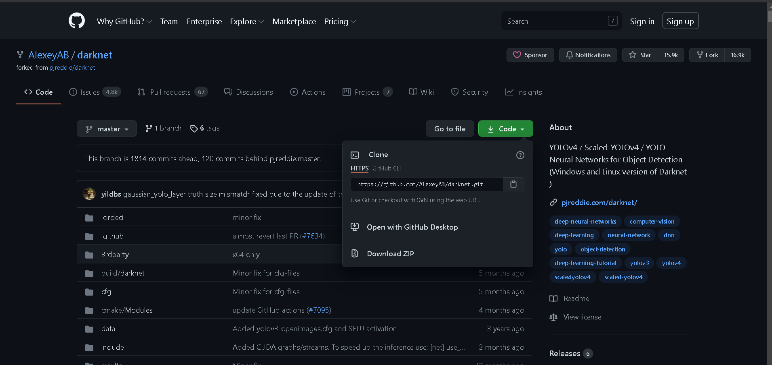
Framework
Darknet
https://github.com/AlexeyAB/darknet.git

Slide 3
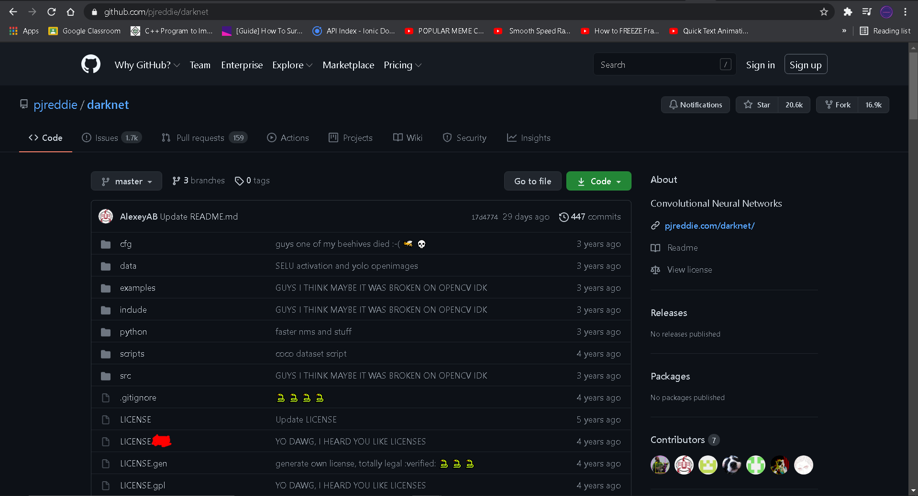
Framework

Slide 4
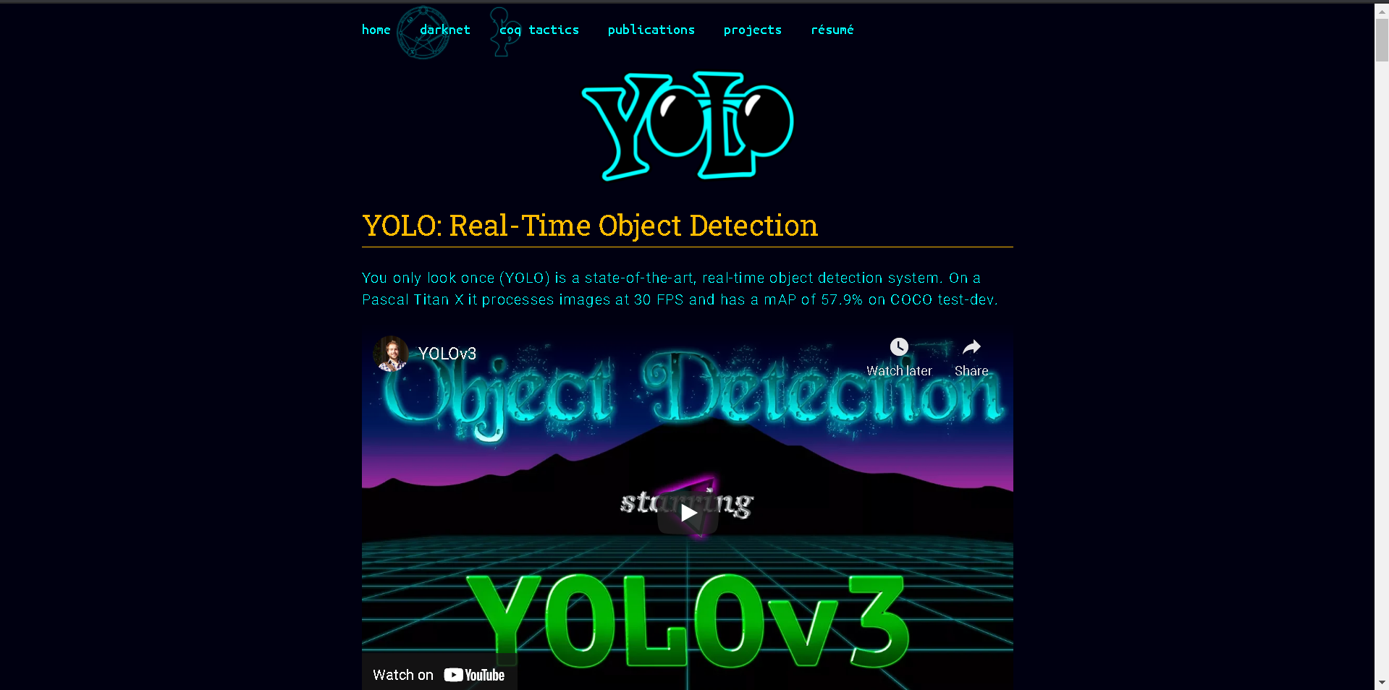
Source Code YOLO
http://pjreddie.com/yolo/ (Redmod, J. et al., 2016)

Slide 5
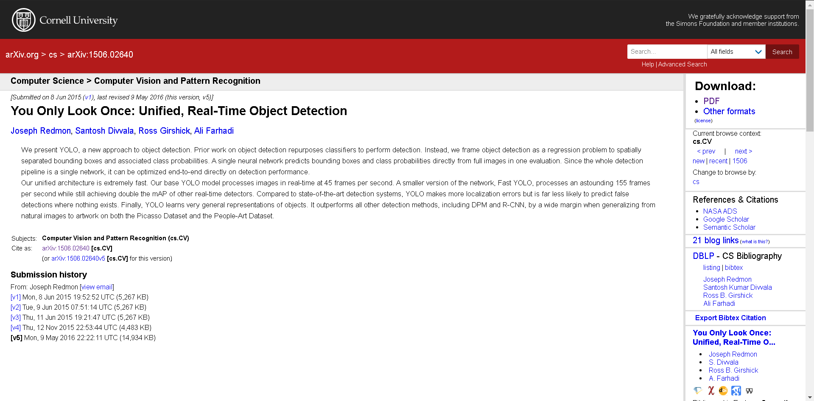
Paper dari YOLO
https://arxiv.org/abs/1506.02640

Slide 6
Requirements
Windows or Linux
CMake >= 3.8
CUDA 10.0 or newer
OpenCV (Pakai opencv-python boleh)
cuDNN >= 7.0 for CUDA
GPU (Untuk video)
MSVC 2015/2017/2019

Slide 7
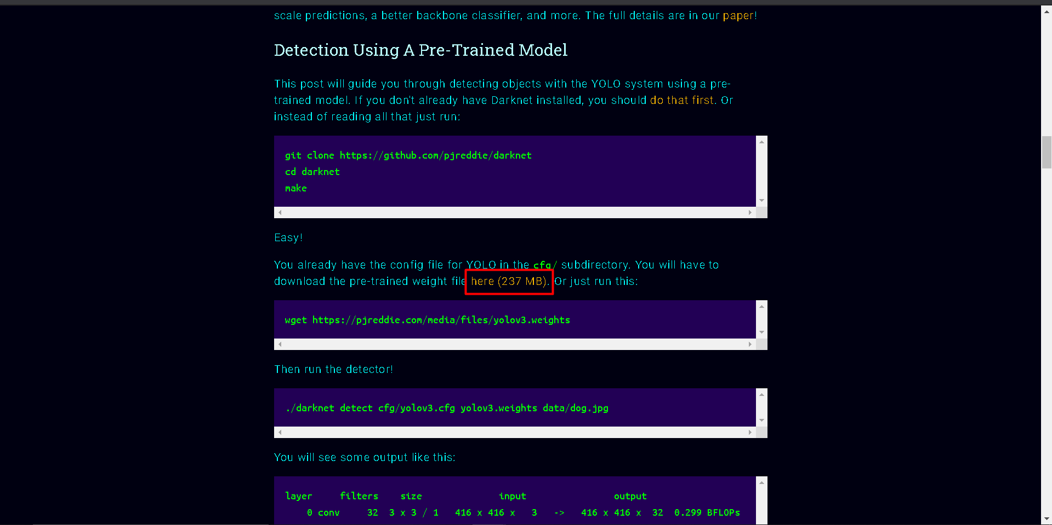
Download YOLOV3 Weights

Slide 8
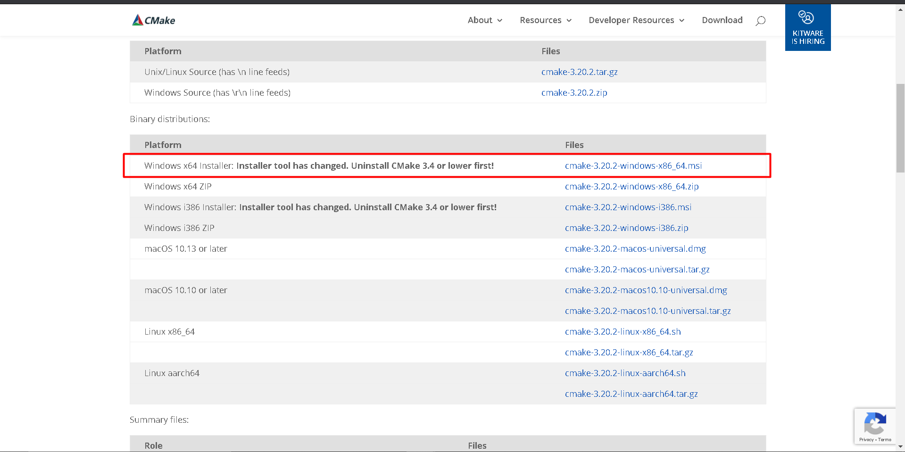
Download CMake
https://cmake.org/download/

Slide 9
CUDA & cuDNN
https://developer.nvidia.com/cuda-downloads (untuk CUDA)
https://developer.nvidia.com/rdp/cudnn-download (Untuk cuDNN)

Slide 10
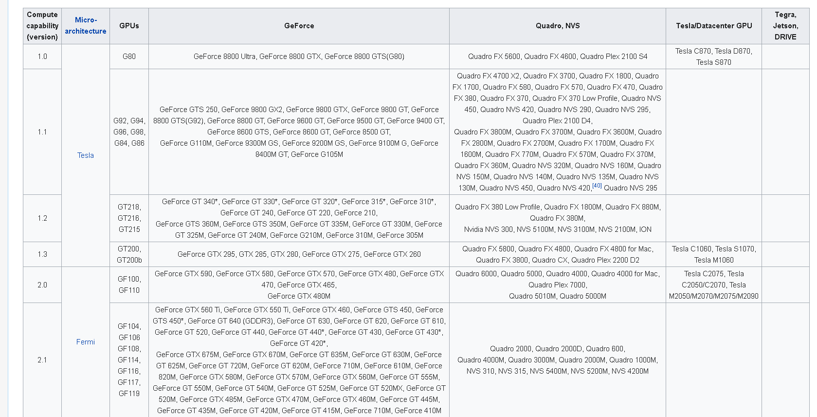
How to Check Your CUDA
https://en.wikipedia.org/wiki/CUDA

Slide 11
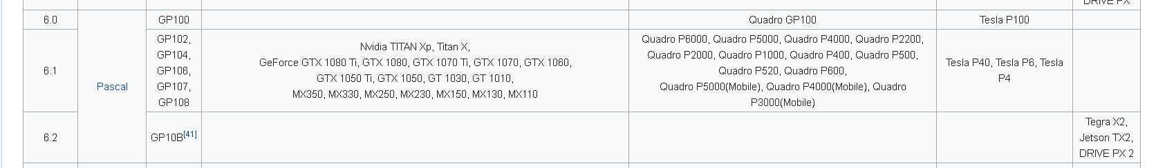
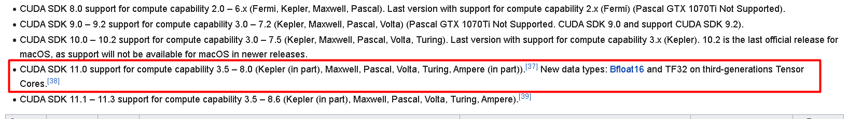
How to Check Your CUDA

Slide 12
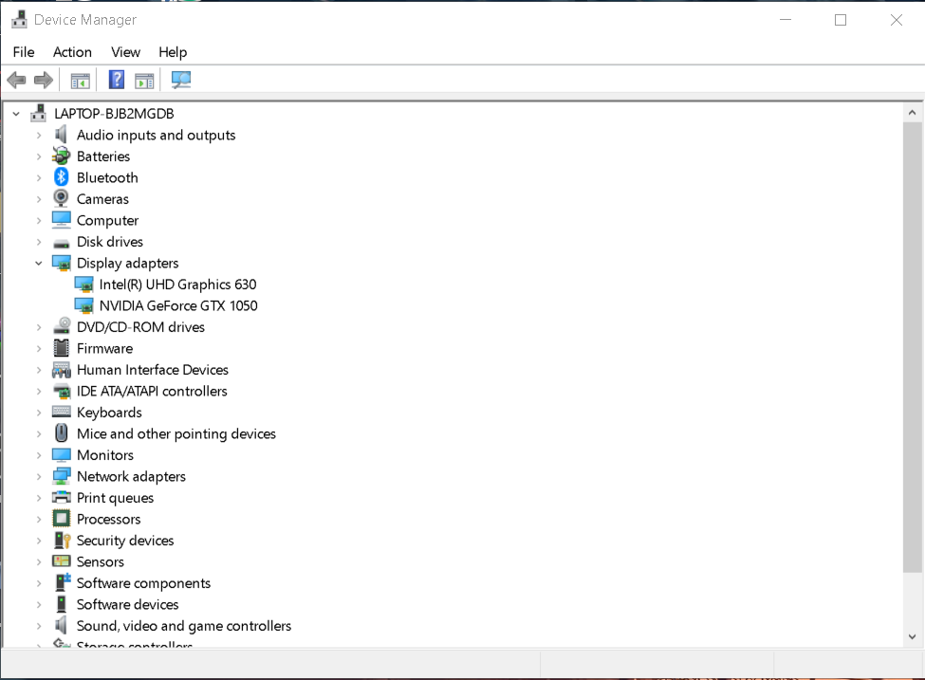
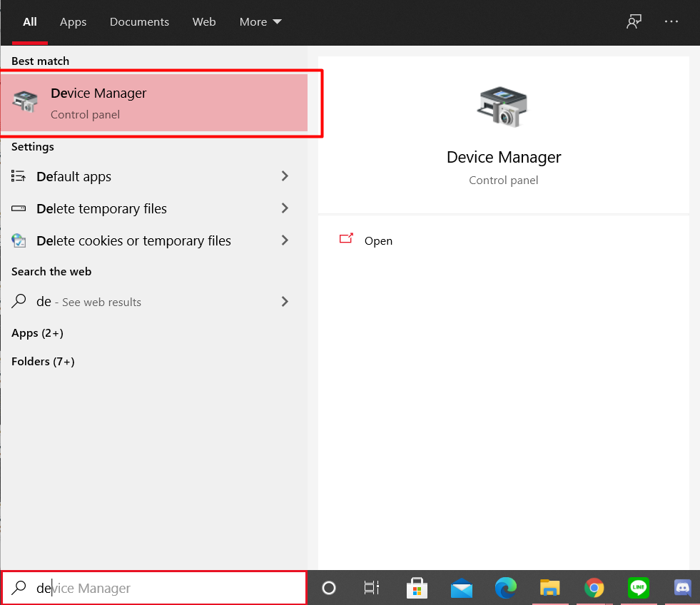
How to Check GPU

Slide 13
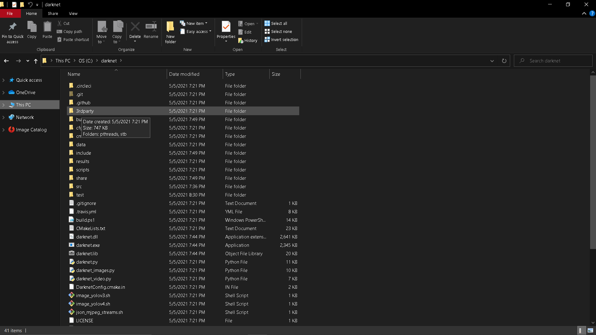
Step 1 - Clone the Framework Repos
git clone https://github.com/AlexeyAB/darknet.git

Slide 14
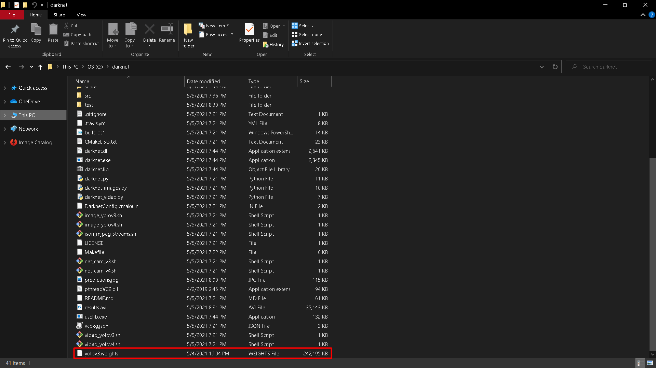
Step 2 - Put Weights File in Repos

Slide 15
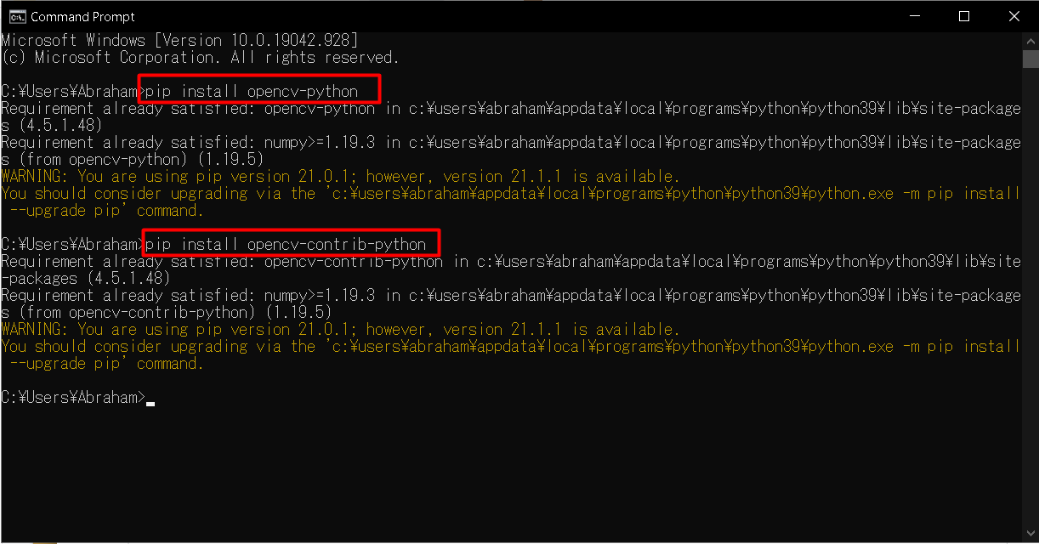
Step 3 - Install OpenCV

Slide 16
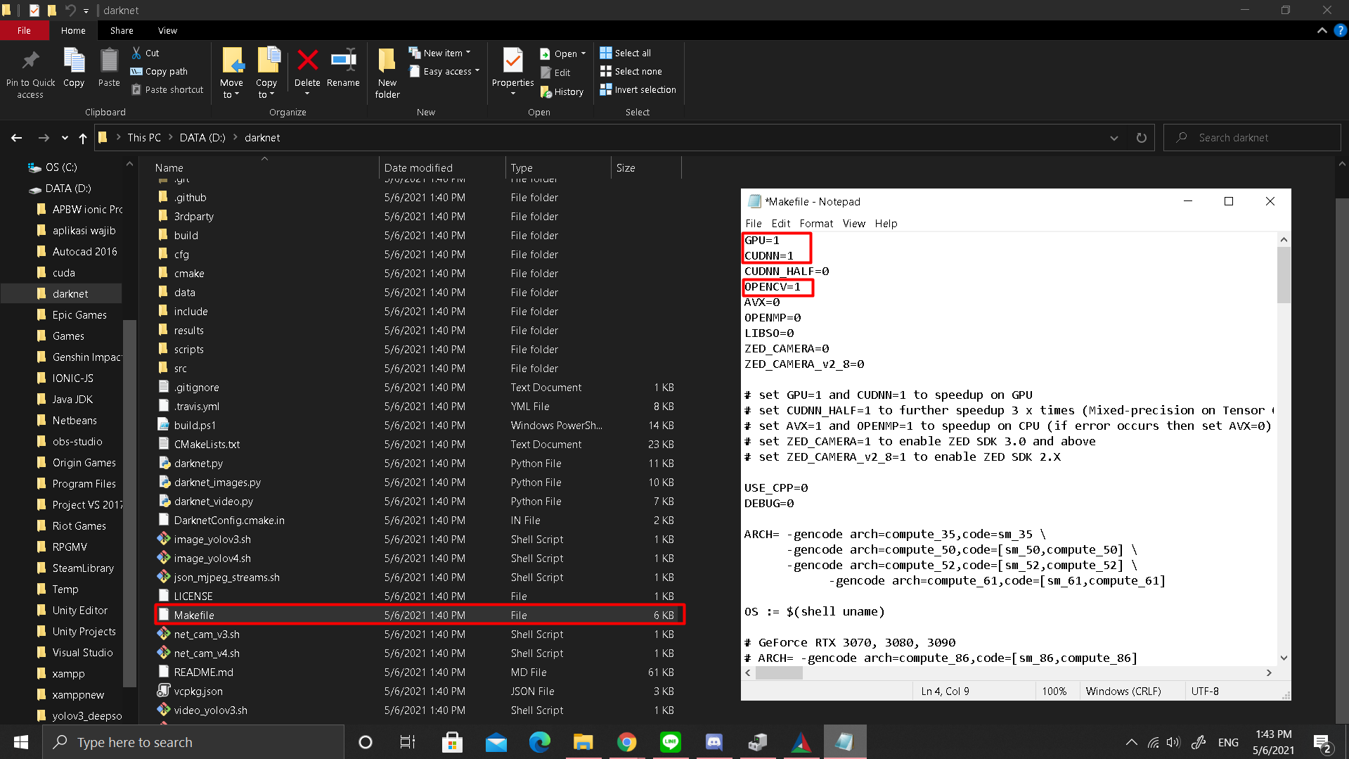
Step 4 - Change “Makefile” file

Slide 17
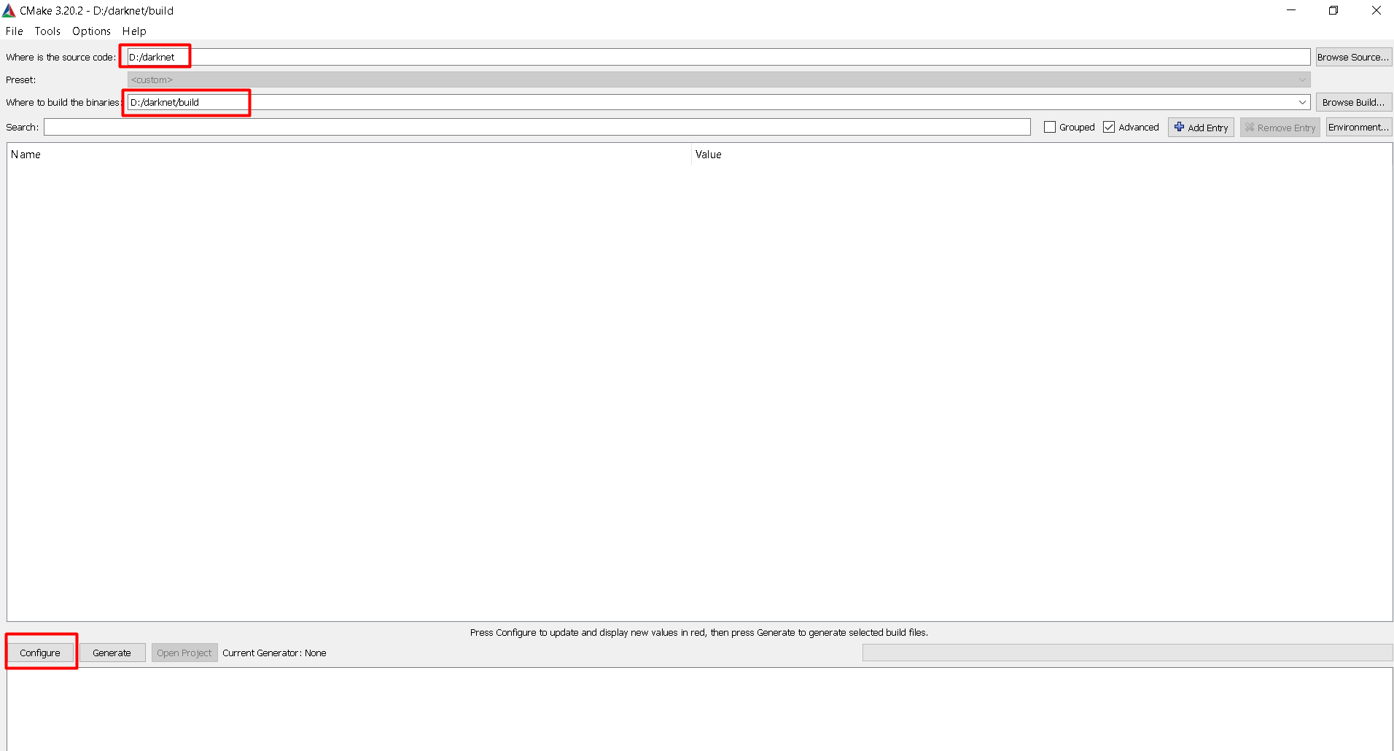
Step 5 - Open CMake, Choose Source Repos and Build repos, and Configure

Slide 18
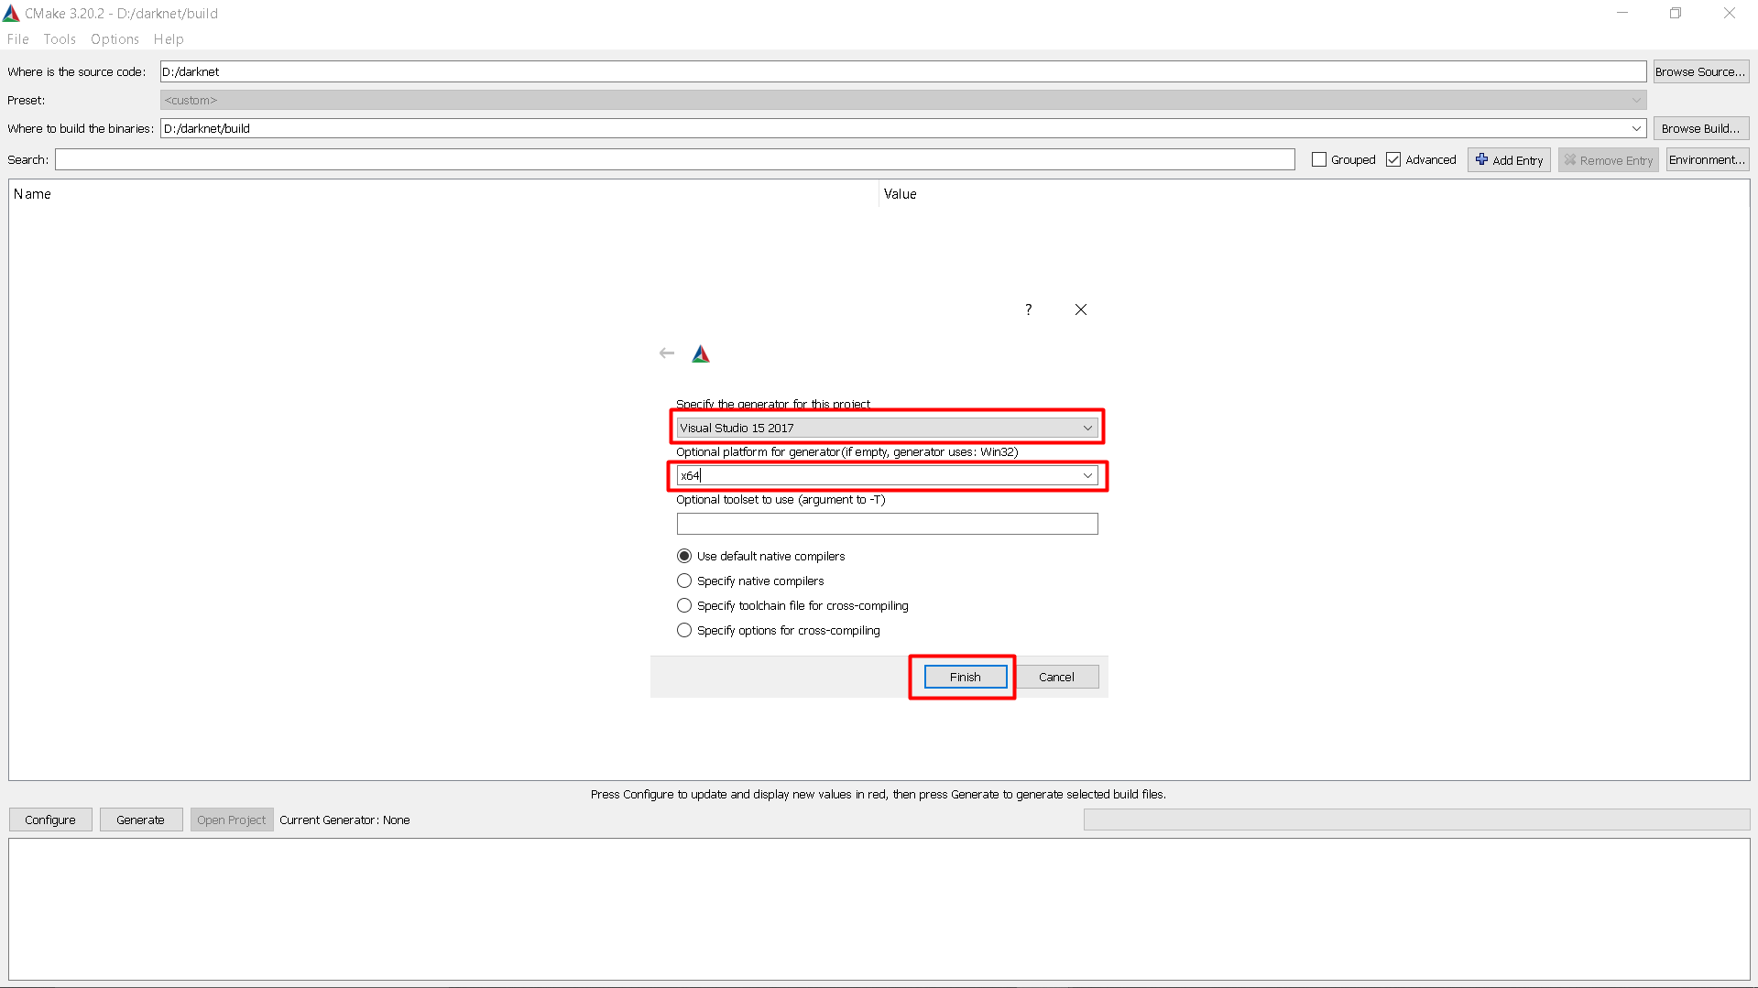
Step 6 - Use Cmake to Configure and Generate Build Code

Slide 19
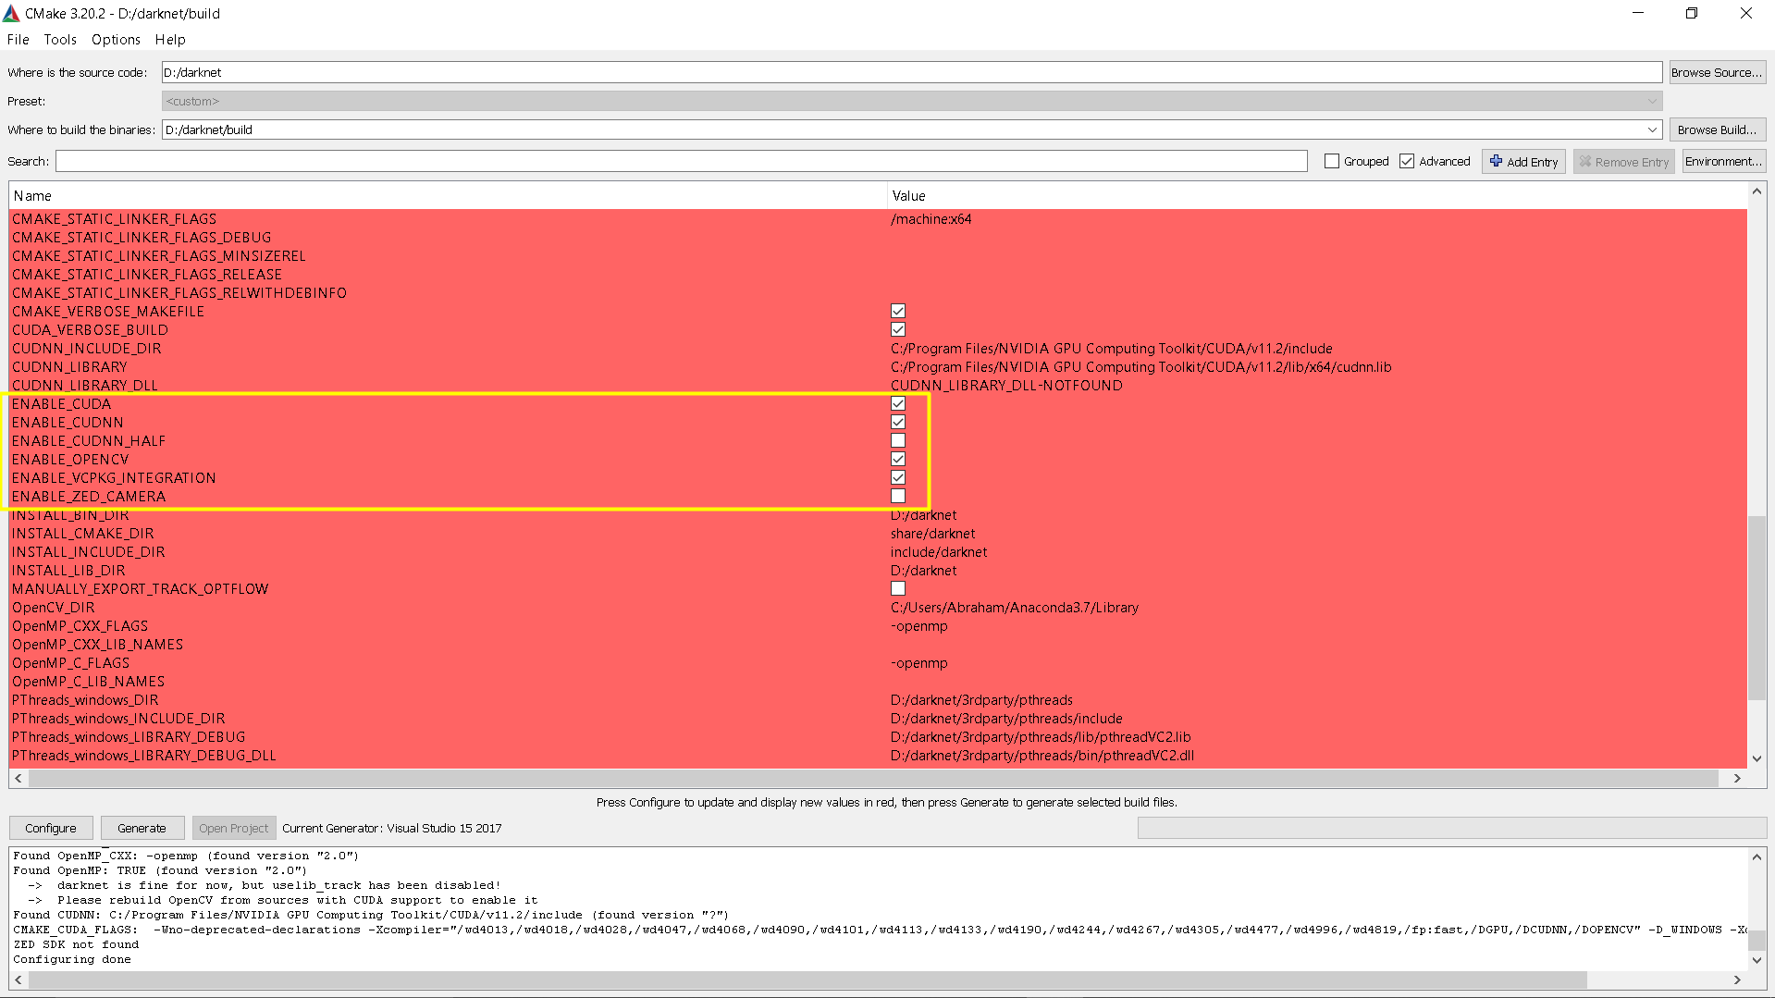
Step 7 - Change some value and Configure again

Slide 20
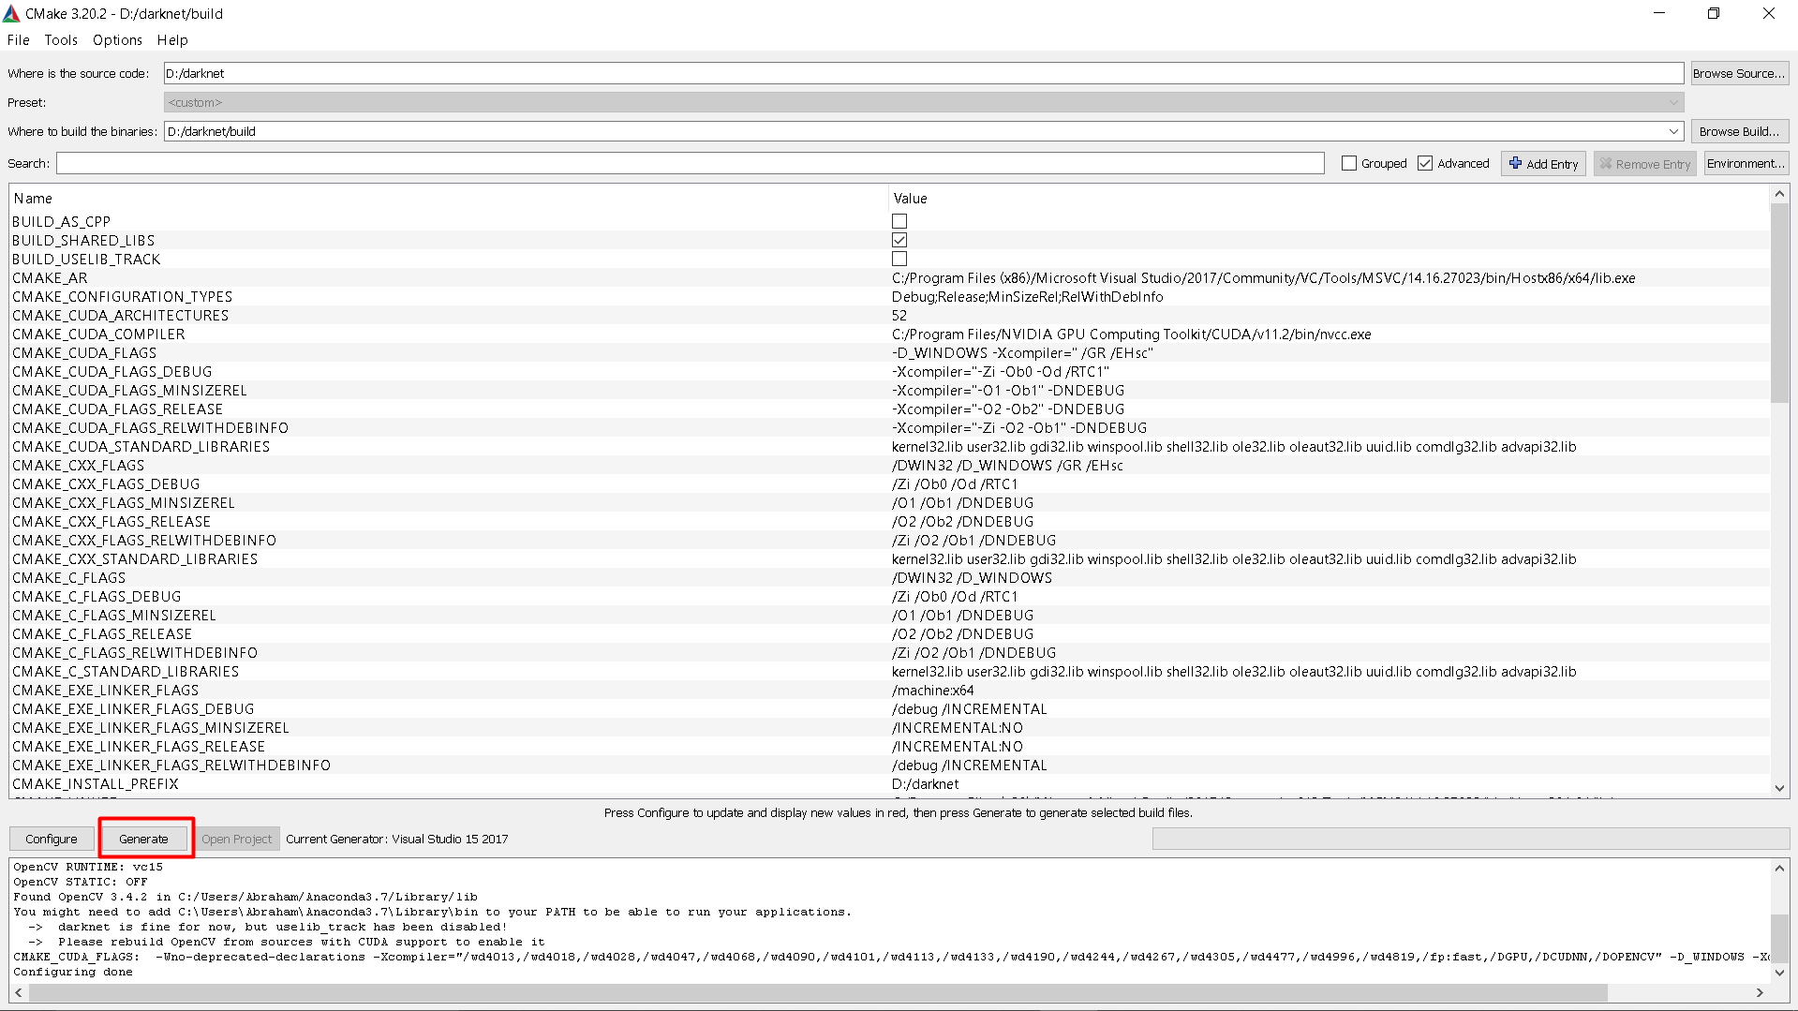
Step 8 - Make sure there aren’t any reds and Generate Code

Slide 21
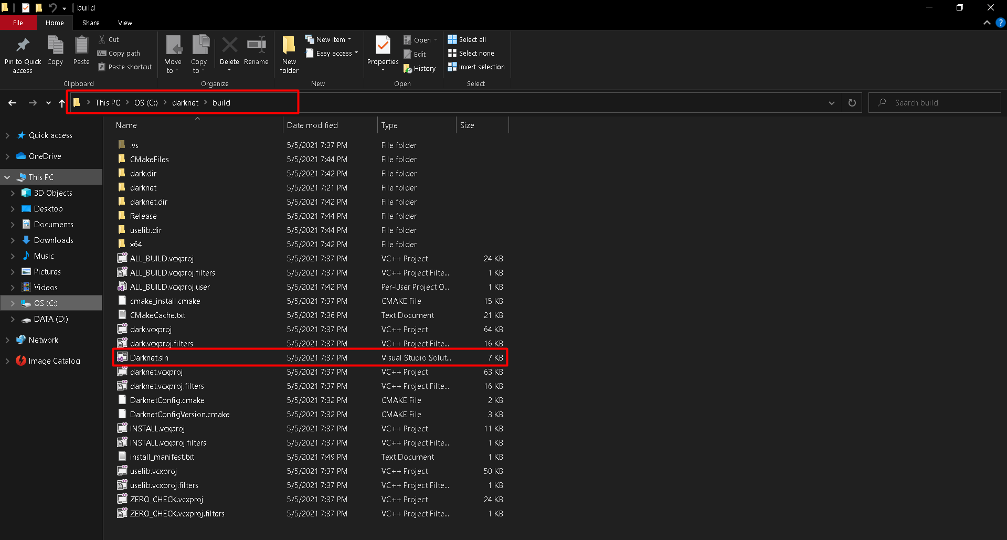
Step 9 - Go to Build Folder and open Darknet.sln

Slide 22
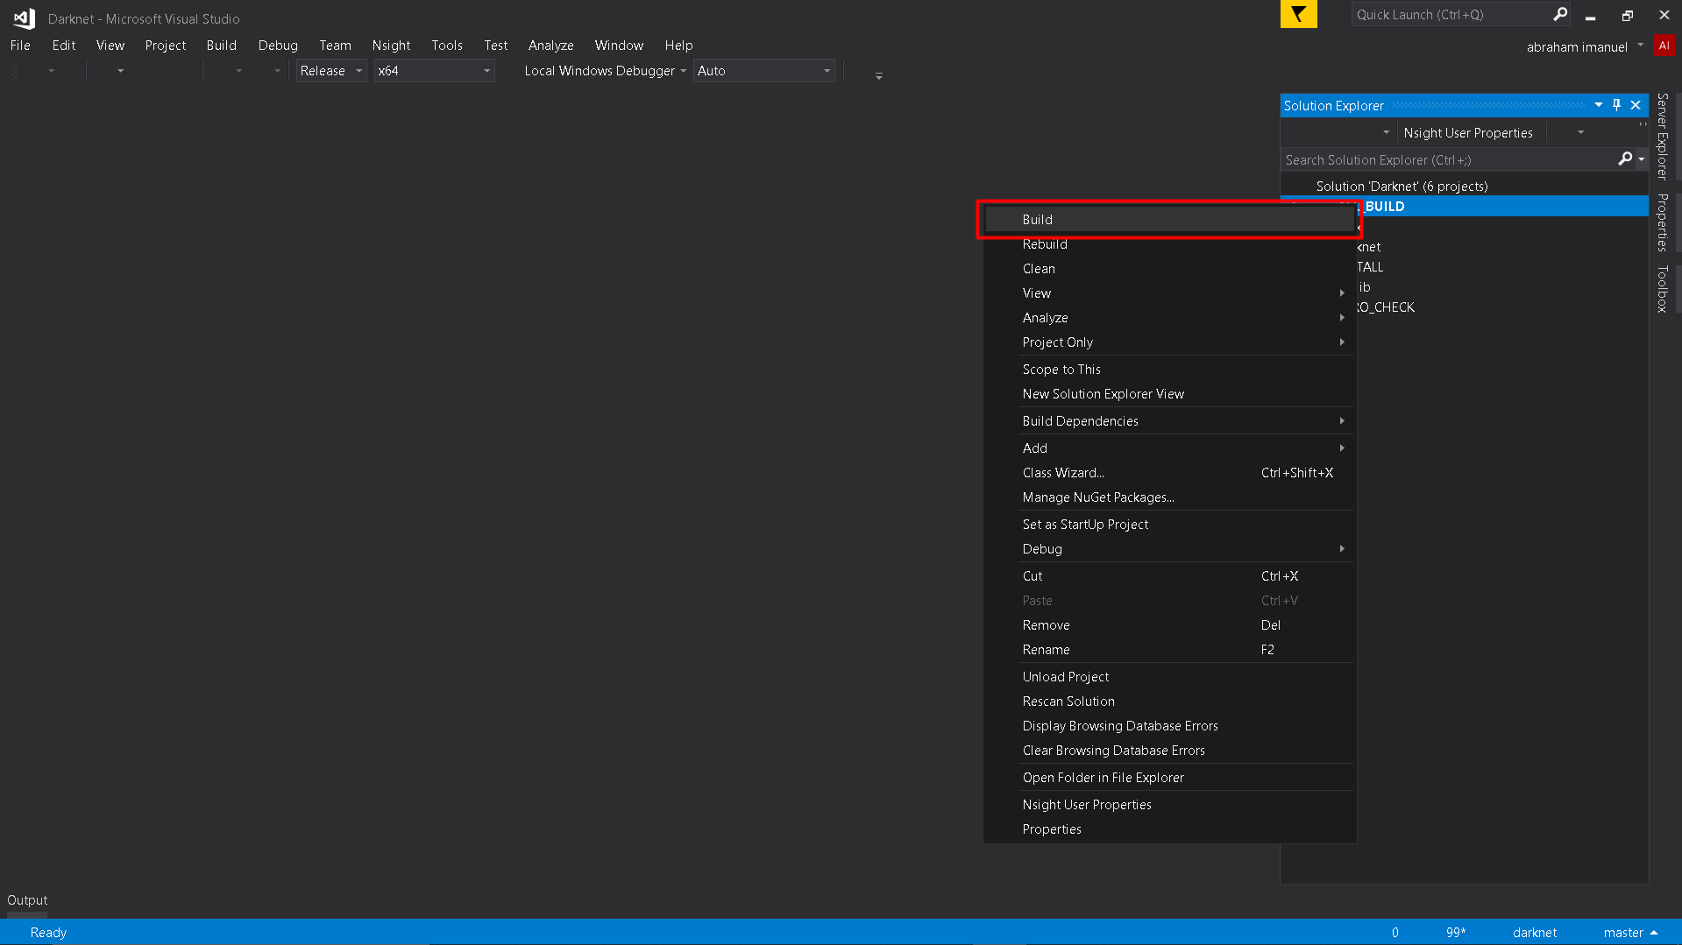
Step 10 - Build “All_Build”

Slide 23
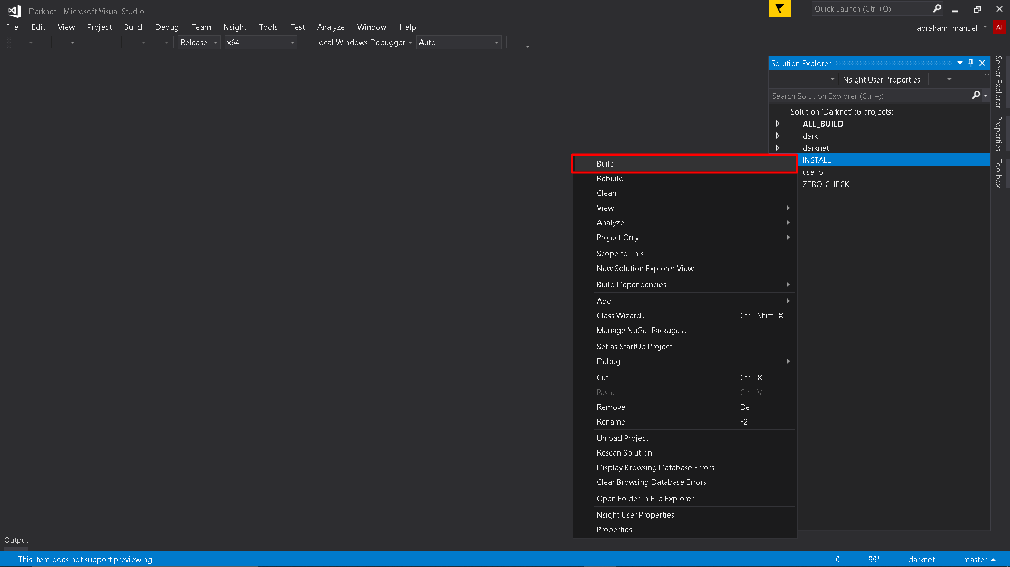
Step 11 - Build “INSTALL”

Slide 24
Step 12 - Demo

